Slide 1

KNOWARTH TECHNOLOGIES PVT.LTD.

Slide 2

KNOWARTH TECHNOLOGIES PVT.LTD.
Internal Guide:-Prof.Jyotika Yadav
External Guide:-Mr. Mitesh Gajjar
By: Varshil Doshi
UI
User Interface

Slide 3


About Company....
KNOWARTH Technologies is an IT services organization. We help our clients implement the solutions as per their business need. We have adopted “one-stop-solution” approach which has helped many of our clients implementing end to end solution.
KNOWARTH has been assisting companies with Technology Consulting, Software Prototyping, Development and with Support. Hence helping them reducing the worry about managing multiple vendor or partners. We have enabled them with a smarter solution, by being their One-stop Solution Partner.

Slide 4








Different Technologies in Web Design & UI (User Interface)

Slide 5
HTML
HyperText MarkUp Language
The full form of HTML is HyperText MarkUp Language...
HTML is one type of markup language that are use for create
Website & Web-pages...
The older version of HTML is HTML 4...
The Latest version of HTML is HTML 5...
HTML 5 is very popular for create website,because HTML 5 is consider many HTML tags & Attributes for better use of HTML...
Example of HTML Page

Slide 6
CSS
Cascading Style Sheet
The full form of CSS is Cascading Style Sheet...
CSS is one type of Style Sheet coding that are use for create
reactive Website & Web-pages & We can apply many styles of t t the element or control,that are use in website..
The older version of CSS is Simple CSS...
The Latest version of CSS is CSS 3...
CSS 3 is very usefull for create reactive website & We can use more style tag in webpage to create more attractive webpage & website...
Example of HTML & CSS Page

Slide 7
JS
Javascript
The full form of JS is Javascript...
Javascript is the programming language of the Web.
Majority of modern websites use Javascript, and all modern web- browsers- on desktops,game console,tablets and smart phones-include Javascript interpreters,making Javascript the most ubiquitous programming language in histrory...
Javascript is part of the triad of technologies that all Web developers must learn:HTML to specify the content of web pages,CSS to specify the content of presentation of web pages, and Javascript to specify the behaviour of web pages...
Example of Javascript using HTML & CSS

Slide 8

TS
Typescript
The full form of TS is Typescript...
TypeScript is a free and open-source programming language developed and maintained by Microsoft. It is a strict syntactical superset of JavaScript...
TypeScript may be used to develop JavaScript applications for client-side or server-side (Node.js) execution...
TypeScript is designed for development of large applications and compiles to JavaScript. As TypeScript is a superset of JavaScript, existing JavaScript programs are also valid TypeScript programs...
Example of Typescript

Slide 9
TS
Typescript
Continue...
Important Concept in Typescript...
Example of Typescript::
Arrow Function
Map Function
Data Structuring
Spread Operator

Slide 10
M
E
A
N
MongoDB
Express js
Angular
Node js
MEAN Stack Application

Slide 11
Serverless Document Publishing Application
This is simple Web-Application..
This Web-Application is used for create Resume & NewsLetter using readymade Templates & Structure which are created by admin in this system..
There are two most usefull concept in this application
1) Serverless
2) MicroService

Slide 12
MEAN Stack Application

Slide 13
Swim-lane Activity Diagram
Serverless Document Publishing Application
(Swim-lane Activity Diagram)

Slide 14
UML of the system
Serverless Document Publishing Application
(Use-case Diagram)

Slide 15
UML of the system
Serverless Document Publishing Application
(Sequence Diagram-user side)
(Sequence Diagram-admin side)

Slide 16
Features of the System
Technological
Functional

Slide 17
Features of the System-Technological
Front End-- Angular 5.2.2, Angular Material Design
MiddleWare-- Node, Express
Database--MongoDB
Other--Serverless,MicroService

Slide 18
Features of the System-Functional
Selection of Resume & NewsLetter Template & Structure..
User can fill the details in Resume & NewsLetter form & also can edit,delete & view the form..
If user wants to download the form,system gives two options like,
PDF & Doc format..
User wants to see the history of their work,It is possible in this system..

Slide 19
Json
Angular json schema Form

Slide 20
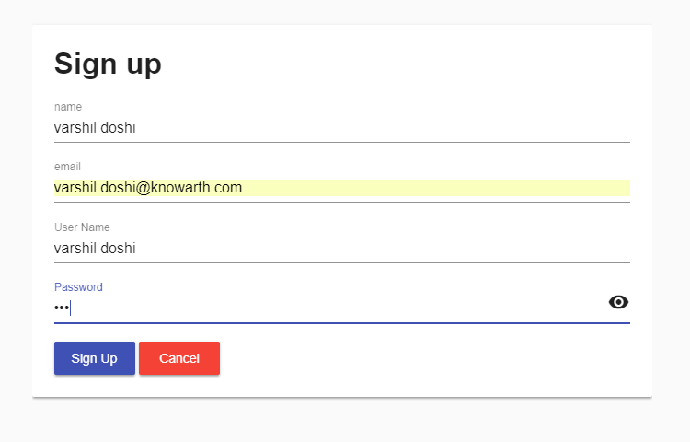
ScreenShot of Sign-Up Page

Slide 21

ScreenShot of Login Page

Slide 22
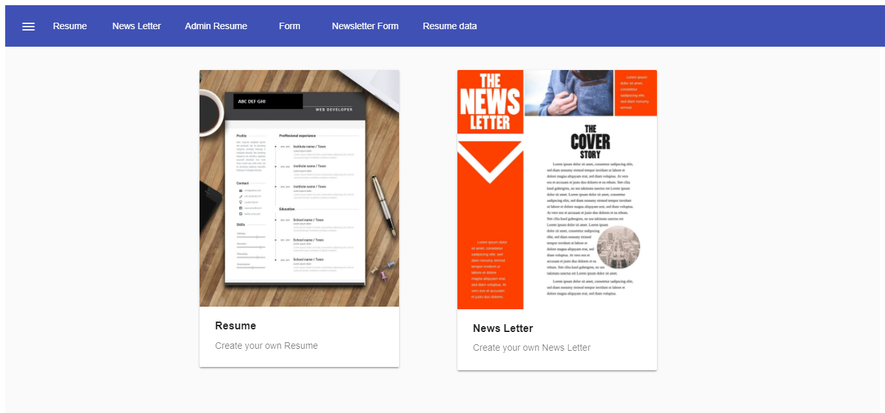
ScreenShot of Dashboard (Home Page)

Slide 23
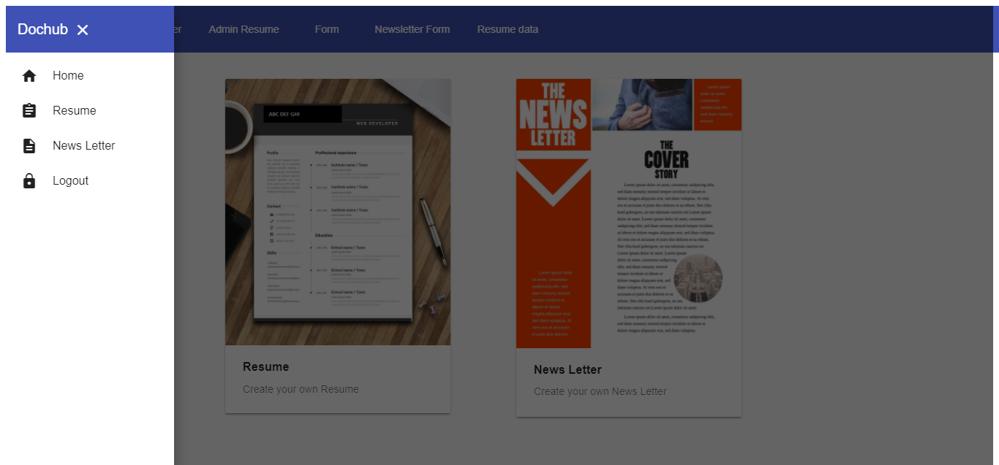
ScreenShot of sidebar

Slide 24
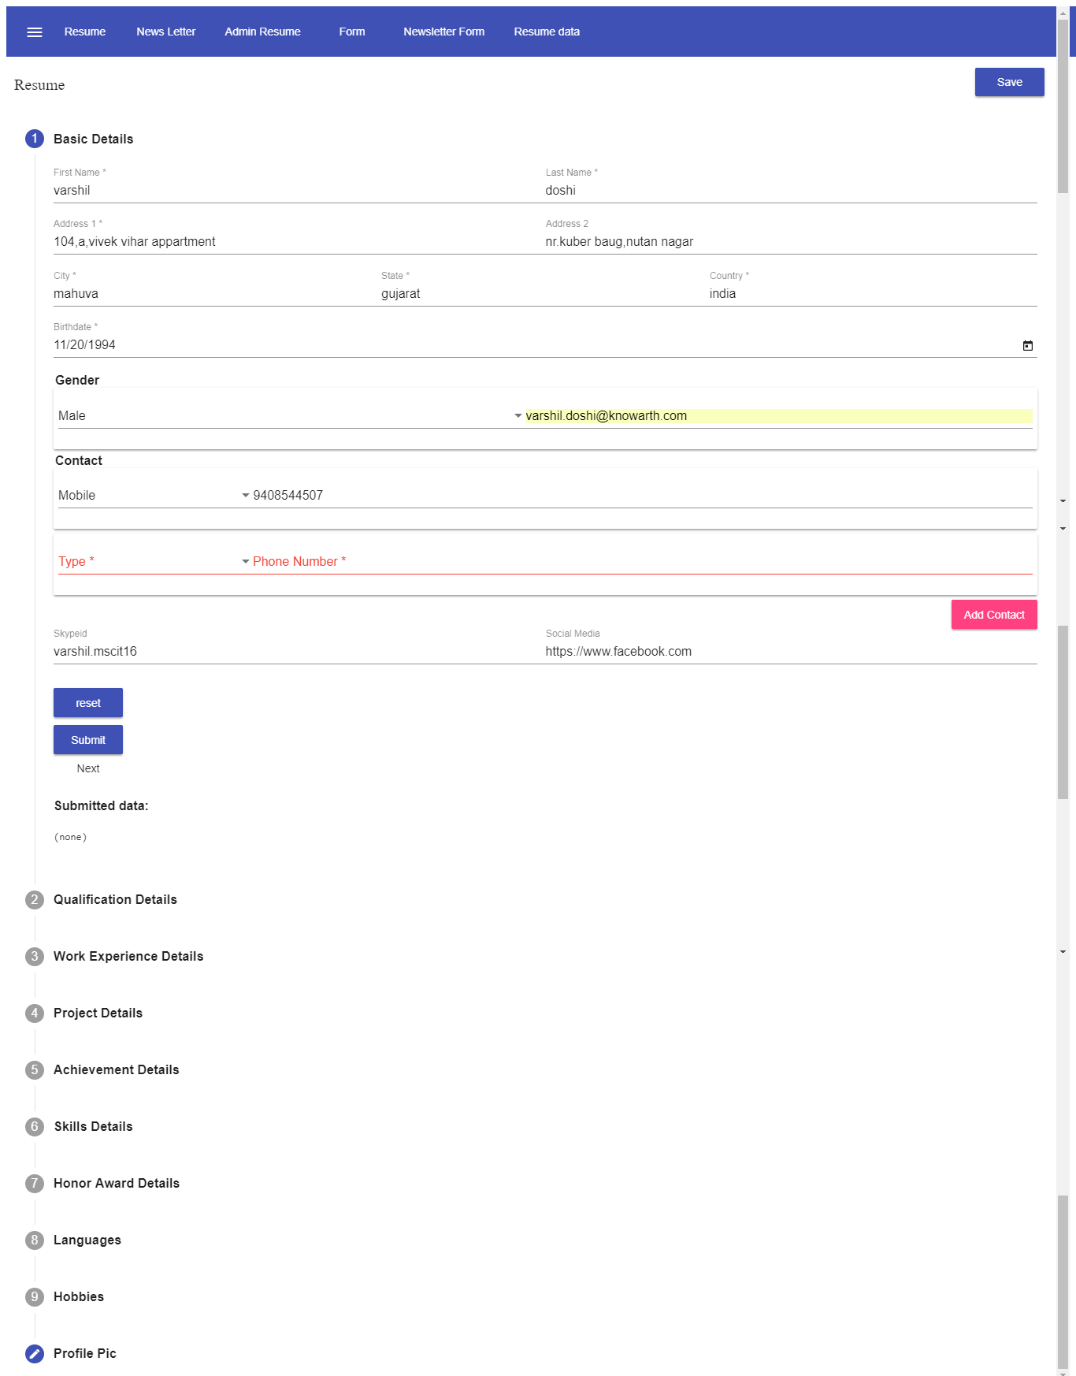
ScreenShot of Resume Data Form

Slide 25
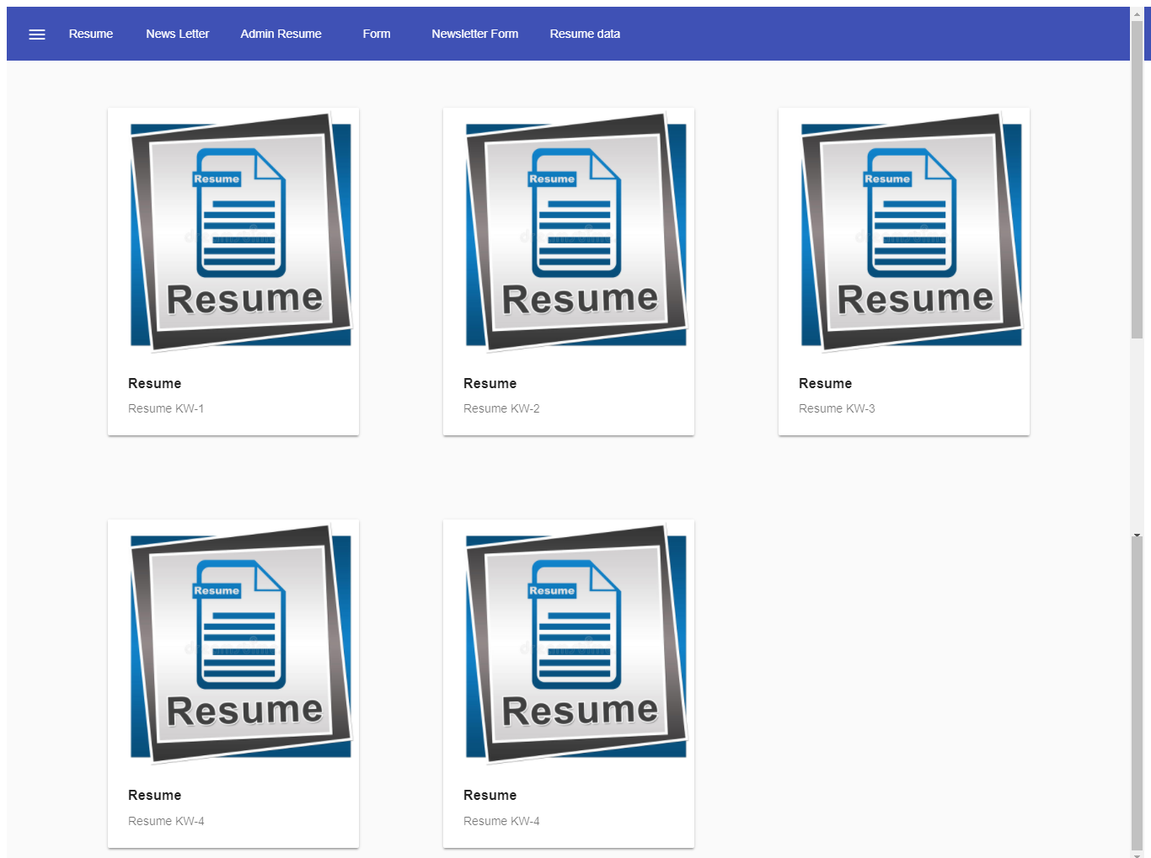
ScreenShot of Resume

Slide 26
Thank You
www.knowarth.com
www.facebook.com/knowarth
www.instagram.com/knowarth
twitter.com/KNOWARTH

